Slide 1
Virtual delivery of Microsoft “In a Day” workshops
Data Modernization Immersion Workshop
Overview Discussion Using Teams
Steve Young - Data & AI CSA (Microsoft)
styoung@Microsoft.com
https://www.linkedin.com/in/steveyoung/. Oct 7, 2020
Notes:
Welcome, My name is Steve Young, I am a Cloud Solution architect specializing in the Data & AI product set.
You were sent an invitation as your organizationa are involved in delivering the Data Modernization In A Day workshop, now rebranded to the Data Modernization Immersion workshop and changed to a virtual delivery. #Because Covid
Go over agenda

Slide 2
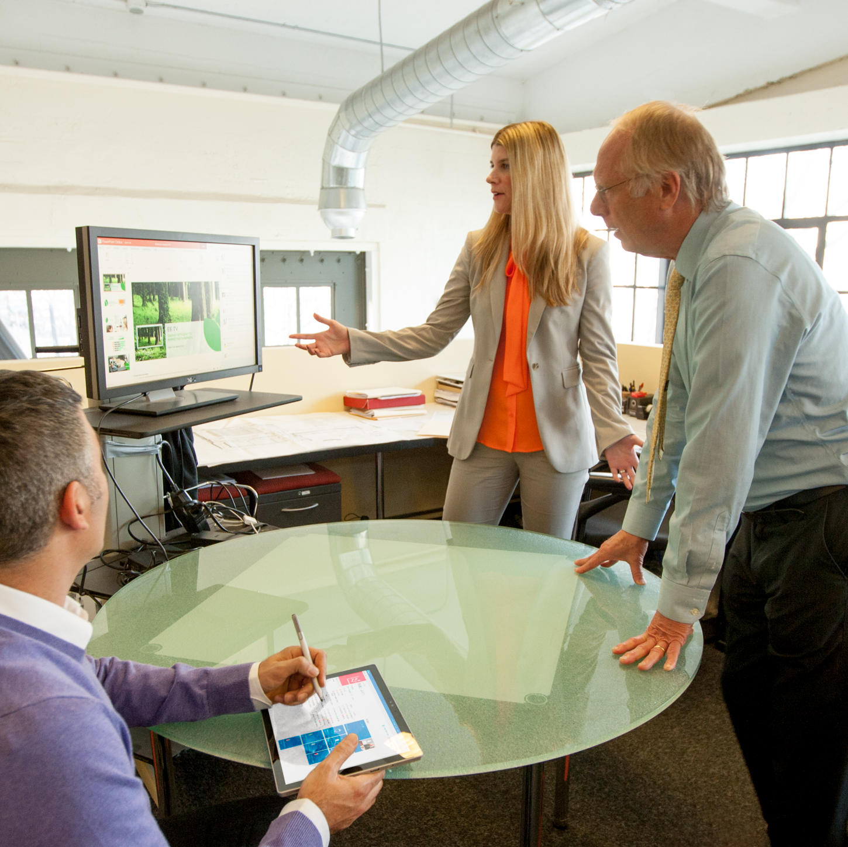
Agenda
Introduction
Program Introduction / Update
Session Resources and content
Tips & Tricks –Digital Delivery
Best Practices for Students
Using Teams for Delivery
Notes:
First and foremost, This is an Open Office Hours, if you have a question, Please ask it.
Our goal is to (Go over the agenda)

Slide 3
Takeaways
Know the updates in the content from In-Person
Some recommendations for virtual delivery
Your questions (hopefully) answered
For Privacy, if you have questions we do not get to, email me
Email: styoung@Microsoft.com
Subject: TTT OfficeHours
GitHub site with this content – 24 hours. https://github.com/steveyoungca/DMIAD_Office_Hours
Partner Content: https://partner.microsoft.com/en-us/asset/collection/microsoft-data-modernization-in-a-day#/
Notes:
Read Takeaways
This slide deck has links that will take you to the discussed content
Go to the Site.

Slide 4
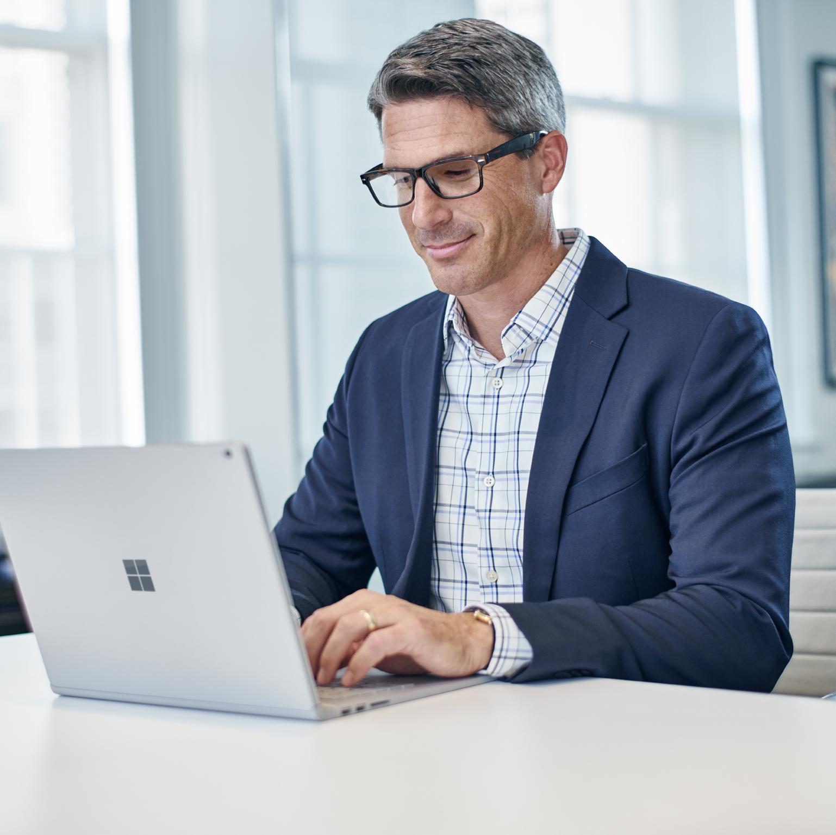
Program and Introduction Overview
Notes:
Lets review the current content and session changes from June

Slide 5
What is a Data Modernization Immersion Workshop?
1-day interactive workshop for TDMs, DBAs & Data professionals covering the value & process of migrating apps & databases to Microsoft Azure
Summary
Free workshop delivered as a 1:Many (or 1:Few) customer engagement – ideal workshop size is ~12 attendees
Offers a complete set of prepared event content, including presenter deck, whiteboard design exercise content, hands-on lab (HOL) setup & facilitation guide, and train the trainer (TTT) recordings
Delivered by geo-based Co-Sell Ready Data Migration partners (see slide 9 for partner requirements)
Goals
Help move customers from the Envision stage to the Validate stage of the sales process
Drive net new – or accelerate existing – pipeline opportunities for Data Migration to Azure
Provide Microsoft field sellers with a scalable customer engagement option specific to Data Migration scenarios
Tee-up next step customer engagements, like Azure Solution Assessments or POCs
Equip partners with the skills needed to eventually run these events to their customers (Thru-Partner model)
Notes:
This is a compressed 1-day interactive workshop which covers the value & a sample process for migrating apps & databases to Microsoft Azure
The goals are important to review as it should focus your message as you deliver the session.
This workshop is meant to Help move your customers from the Envision stage to an actual project
Helps move the sales process along

Slide 6
Part of “Azure Immersion Workshop” portfolio
Microsoft’s Azure product marketing & partner (OCP) teams have created and launched a family of these 1-day interactive customer workshops that build on the proven success of the 1:Many customer immersion type of event
Data Modernization is joined by other immersion workshops (Analytics, AI, Cloud Native, .NET Modernization, Infrastructure Migration, and WVD) to provide you, our top data migration partners, with a series of engagement opportunities to work with Microsoft field teams and engage customers in repeatable & scalable ways – all with the goal of driving pipe growth & velocity for key Azure services
Notes:
Not the only session, more are being added such as (Analytics, AI, Cloud Native, .NET Modernization, Infrastructure Migration, and WVD)

Slide 7
Data Modernization Azure Immersion Workshop (formerly DMIAD) Agenda – Updated for FY21
Morning – Data Migration: Value & Planning
9:00 – 10:00 Data Migration overview, case studies, migration triggers, customer timelines, TCO value
10:00 – 11:00 Using Data Migration tools & frameworks to assess/build business case for cloud
11:00 – 12:00 Whiteboarding exercise (assessing environment, destination considerations, etc.)
LUNCH BREAK from 12:00 – 1:00
Afternoon – Data Migration: Hands-On Exercises
1:00 – 1:15 Introducing HOL process & goals for the afternoon
1:15 – 2:30 Hands-On Lab: Migrating SQL Databases to Azure (Managed Instance)
2:30 – 3:00 Next steps & closing comments
L100
L200
L300
Notes:
This is the modified agenda. Same content, but One HOL
Review the agenda

Slide 8
Changes From Original Content
The topical content (Morning Sessions 1 & 2) remain the same, and the partner can use the existing PPTs – there are also recordings of these to help trainers learn how to present them
The Whiteboarding session is meant to be a lecture/seminar style of delivery where the trainer walks attendees through the process of diagraming a migration motion based on specific customer information
The Whiteboarding guide is included in the MPN BOM and contains all of the information on the customer scenario
The partner can share their screen during this portion and use either slides that build (showing what they would normally draw on a whiteboard), or use a live digital whiteboarding approach (e.g. using their touchscreen & stylus to whiteboard in real time)
Notes:
From email – read the slide,

Slide 9
HOL Guidance and Support
There’s only one HOL now for DMIW (the one focused on SQL DB Managed Instance)
The link to this lab in the MPN BOM has all the information in it for setting up the lab (provisioning the VM, etc.)
The process of requesting lab access codes is triggered by submission of the event nomination form (required)
The PMO team handles this part and will provide codes for the proper number of HOLs
As for facilitating the HOL process digitally, our lab company (Spektra) has a trainer view that allows the facilitator to see progress being made by attendees, and has the ability for the trainer to pop-in to a student’s VM and help them out if they’re stuck (if Softchoice needs more info on this, they can reach out to cloudlabs-support@spektrasystems.com
As for “day-of-event” support, there will be a Spektra person on standby if anything happens, and they can be accessed two ways: (1) e-mail at cloudlabs-support@spektrasystems.com, or (2) via Teams at http://bit.ly/cloudlabs-support
When reporting an issue, include the following information
Which HOL you’re running
The Request ID # (from original event HOL request)
The e-mail address or Deployment ID (odl_user_<id>@msazurelabs.onmicrosoft.com) of the attendee having the issue
Notes:
From Email – read the slide
A bit of a word salad, but let me put the link in the GitHub repo

Slide 10
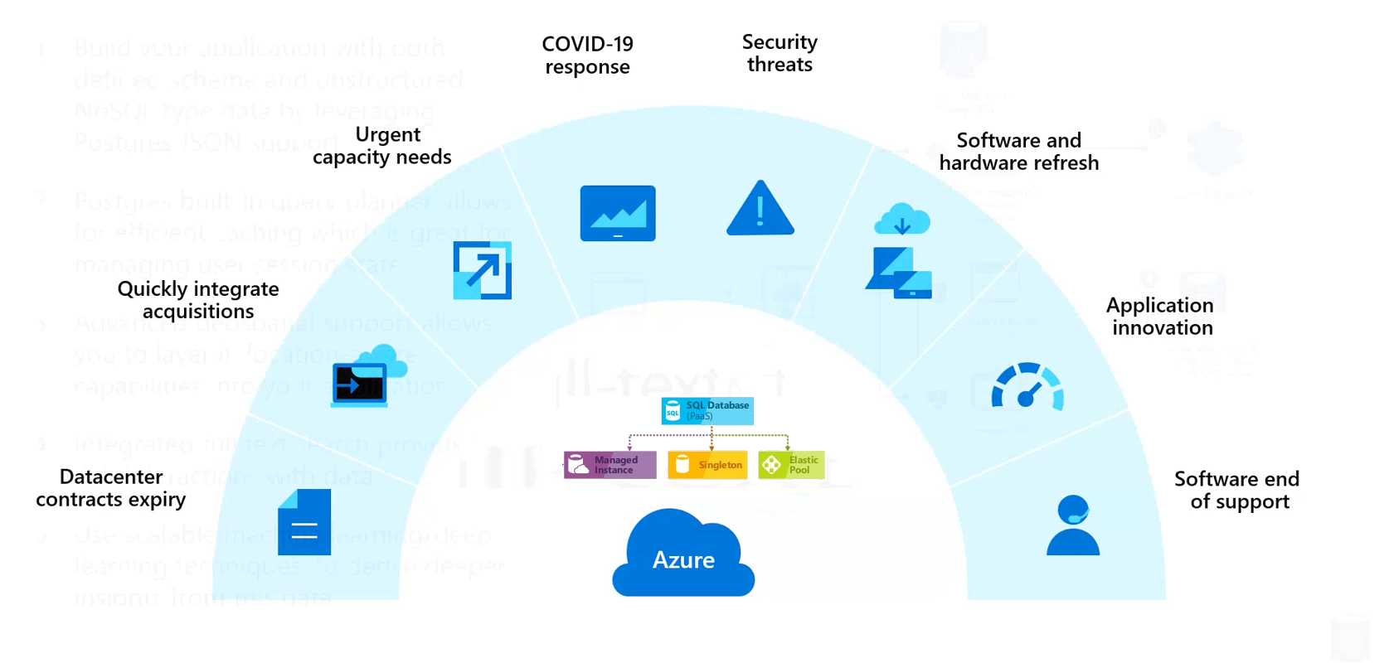
Cloud Migration Triggers
Notes:
Mention the deck of some slides if you need them.

Slide 11
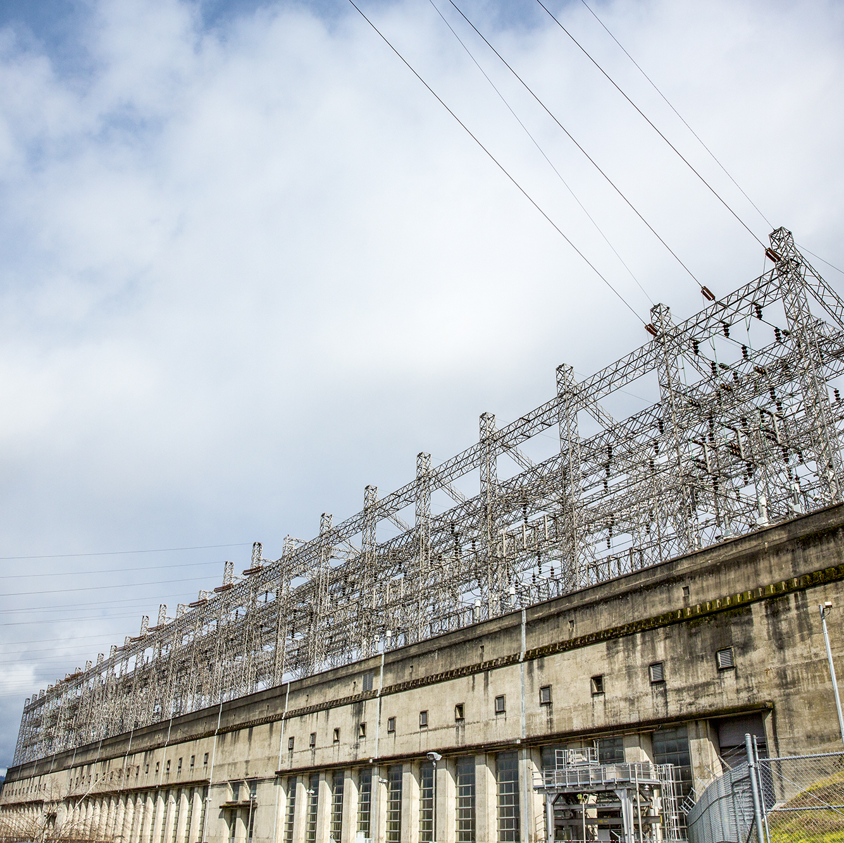
Data Mod Immersion Workshop Agenda Session Resources

Slide 12
DMIAD TTT: Morning Session 1
Morning Session 1
Time Slot: 9:00-10:00AM
Topic: Why modernize your SQL Server to Azure
Flow:
Part 1: Why modernize: The business value of cloud migration
Part 2: SQL Server migration destinations in Azure (choosing between SQL DB, MI, VM)
Part 3: Database total cost of ownership in Azure (AHB, TCO calc overview)
Session Presentation Deck & TTT Recording:
https://assetsprod.microsoft.com/mpn/en-us/dmiad-morning-session-one-content.pptx
https://partner.microsoft.com/en-us/asset/detail/dmiad-morning-session-one-recording-mp4
Notes:
Review the Session, read the slide and go to the link to show it.

Slide 13
DMIAD TTT: Morning Session 2
Morning Session 2
Time Slot: 10:00-11:00AM
Topic: How to migrate and modernize your SQL Server databases
Flow:
Part 1: How to migrate to Azure using Azure Migrate, Data Migration Assistant, and Azure Data Migration Service
Part 2: Picking a pilot application and database to migrate
Part 3: Optimizing your Azure workload
Session Presentation Deck & TTT Videos:
https://assetsprod.microsoft.com/mpn/en-us/dmiad-morning-session-two-content.pptx
https://partner.microsoft.com/en-us/asset/detail/dmiad-morning-session-two-recording-one-mp4
https://partner.microsoft.com/en-us/asset/detail/dmiad-morning-session-two-recording-two-mp4
Notes:
Review the Session, read the slide and go to the link to show it.

Slide 14
Data Mod AIW TTT: Whiteboarding
Facilitator Guide link: https://partner.microsoft.com/en-us/asset/collection/microsoft-data-modernization-in-a-day#/
Whiteboarding
WDS Trainer Guide
Time Slot: 11:00AM-Noon*
Topic: Migration Planning Whiteboarding Exercise
Flow:
Introduce case study to the attendee(s)
Guide attendee(s) through the process of identifying business need & overcoming objections
Guide attendee(s) through the process of designing a proof of concept (POC) to address customer scenario
Review final design
*Note: Facilitator guide shows 1hr 15 min for this session, so use best discretion on actual timing for this
Abstract:
This interactive whiteboarding session is designed to help attendees better understand how to build a Proof-of-Concept (POC) and conduct a site analysis for a customer to compare cost, performance, and level of effort required to migrate from Oracle to SQL Server. As a facilitator, you will help the attendee(s) evaluate the dependent applications and reports that will need to be updated and (as a group) come up with a migration plan. In addition, the design-building process should help attendee(s) understand how the customer can take advantage of new SQL Server features to improve performance and resiliency, as well as explore ways to migrate from an old version of SQL Server to the newest version and consider the impact of migrating from on-premises to the cloud.
Learning Objectives:
Develop a plan for migrating on-premises VMs and SQL Server 2008 R2 databases into a combination of IaaS and PaaS services in Azure.
Utilize database assessment to reveal any feature parity and compatibility issues between the customer's SQL Server databases and the managed database offerings in Azure using Data Migration Assistant.
Design a solution for migrating their on-premises services, including VMs and databases, into Azure, with minimal or no down-time.
Provide guidance on how to enable some of the advanced SQL features available in Azure to improve security and performance in the customer's applications.
https://github.com/microsoft/MCW-Migrating-SQL-databases-to-Azure/blob/master/Whiteboard%20design%20session/WDS%20trainer%20guide%20-%20Migrating%20SQL%20databases%20to%20Azure.md#abstract-and-learning-objectives
Notes:
Review the Session, read the slide and go to the link to show it.
Lab 2 on the portal should be replaced with exercise 2 on lab 1
If provisioning is an issue, a plan B could be https://docs.microsoft.com/en-us/azure/dms/tutorial-sql-server-to-managed-instance

Slide 15
Data Mod AIW TTT: Hands-On Lab (HOL)
HOL
Time Slot: 1:15-2:30PM
HOL Topic: Migration Using Azure SQL Database Managed Instance
Description:
This covers migration from SQL Server 2008 R2 on prem to Azure SQL DB MI and uses the following tools/services:
Azure Migrate
Latest Data Migration Assistant (DMA) + SKU Recommender, + upload to Azure Migrate
Data Migration Services (DMS) online migration
Link to HOL Content
https://github.com/microsoft/MCW-Migrating-SQL-databases-to-Azure/blob/master/Hands-on%20lab/HOL%20step-by-step%20-%20Migrating%20SQL%20databases%20to%20Azure.md
Note: In the unlikely event that the HOL server goes down (and support cannot rectify it), please consider walking attendees through the following tutorial instead = https://docs.microsoft.com/en-us/azure/dms/tutorial-sql-server-to-managed-instance
Facilitator content: https://partner.microsoft.com/en-us/asset/collection/microsoft-data-modernization-in-a-day#/
Notes:
Hand on lab. See the slide in the previous section.

Slide 16
DMIAD TTT: Concluding the Day
Next Steps & Closing Comments
The process of wrapping up the workshop should focus on:
Reviewing highlights from the day ("what we learned") - remember to ask the attendee(s) what stood out as enlightening
Reflecting on some specific questions that were asked and noting ones that require research & follow-up
Putting what was learned into practice in the attendee's organization
This is the most important aspect of closing out the session because it serves to build a bridge between the workshop and what comes next = actually planning & executing the migration
Set the expectation that this is just an initial part of the journey and that it's important to work with Microsoft & its partners to keep the momentum going in the form of follow-up meetings, assessments, POCs, etc.
Thanking them for their time
Express our gratitude in a way that acknowledges that they took valuable time away from their roles (in some cases billable hours lost) to come to the workshop and learn about the importance of migrating their apps & databases to Azure
Post-Event Attendee Evaluations:
Ask the attendees to please fill out the post-event evaluations ASAP (so their feedback is still fresh in their minds)
Notes:
Just like you would normally conclude a session
Reviewing highlights from the day ("what we learned") - remember to ask the attendee(s) what stood out as enlightening
Reflecting on some specific questions that were asked and noting ones that require research & follow-up
Make it real – what should our customer/prospect do next?
Putting what was learned into practice in the attendee's organization
This is the most important aspect of closing out the session because it serves to build a bridge between the workshop and what comes next = actually planning & executing the migration

Slide 17
Tips and tricks Converting Motions to Virtual (Digital)

Slide 18
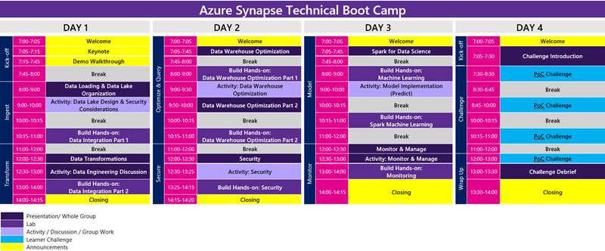
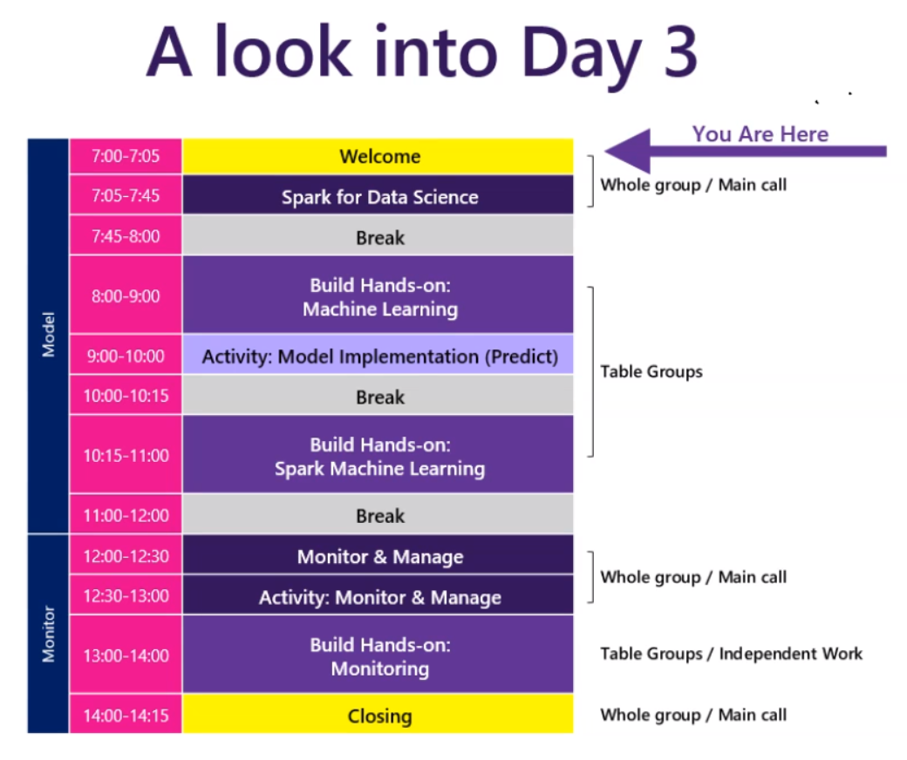
Schedule Your Day
Notes:
I attended a session recently and this was the schedule
Lots of breaks,
No One likes to talk, like pulling teeth some times as the attendees can hide
For multi day – Teams has a Breakout room feature.

Slide 19
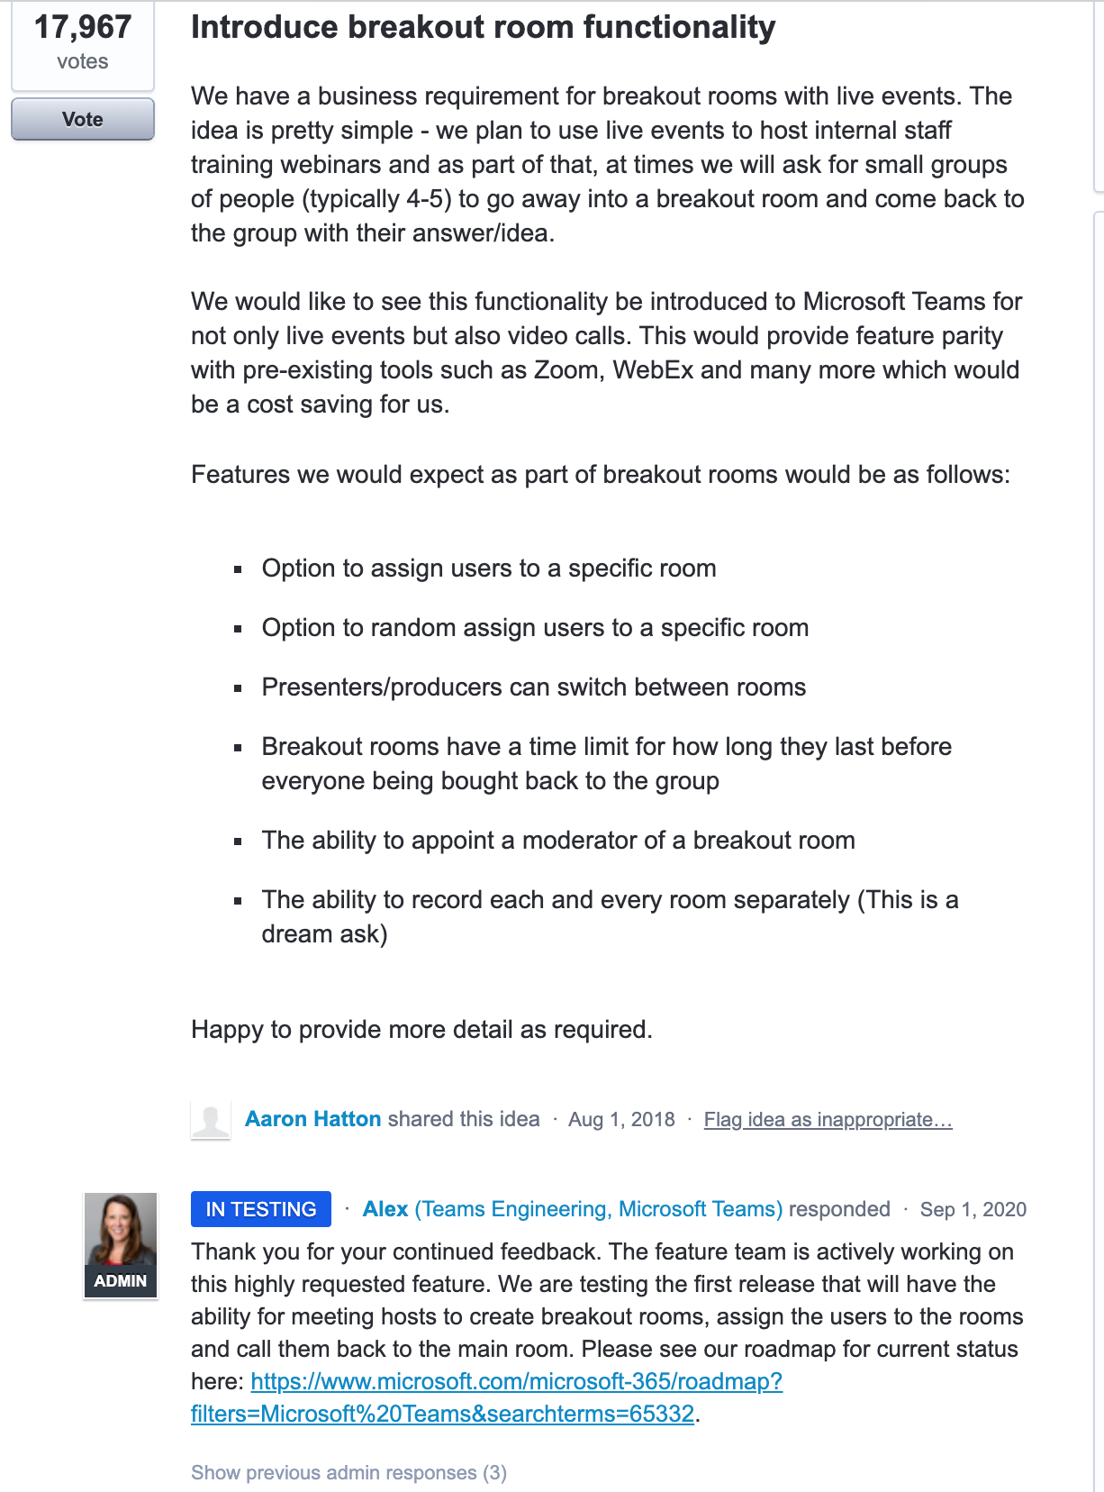
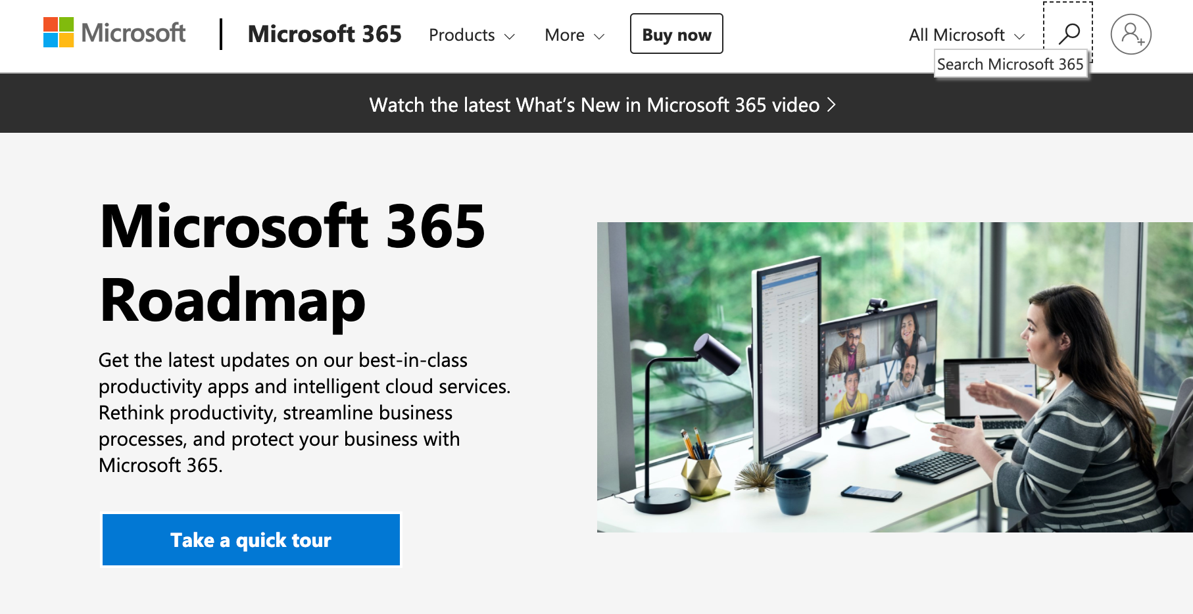
Microsoft Teams Breakout Rooms - Preview
Check out the Roadmap from time to time
https://www.microsoft.com/en-ca/microsoft-365/roadmap?filters=
https://microsoftteams.uservoice.com/forums/555103-public/suggestions/35000044-introduce-breakout-room-functionality
Notes:
We will cover more about teams in a later section.

Slide 20
Teams for Distance Learning
There are many choices. Important to understand what features / benefits are of highest value:
The TSfB Program selected Teams http://aka.ms/successwithteams
Audio Quality is critical
Video is used by Trainer only for Module Introductions
Chat is highly encouraged
Screen share only by Trainer
Whiteboarding
Built in Teams Feature
Microsoft Whiteboard
Freehand by Invison
Polling and Q&A abilities
https://www.mentimeter.com/

Slide 21
Hardware Setup for Trainers
Trainer Setup:
Minimum of two monitors, some use 3 or 4
Staging Monitor
PPT Presenter Monitor
PPT Slide Show (shared)
Student View
Drawing device (Surface or Wacom)
Alternative audio devices (Jabra 710 and Jabra Evolve 65)

Slide 22
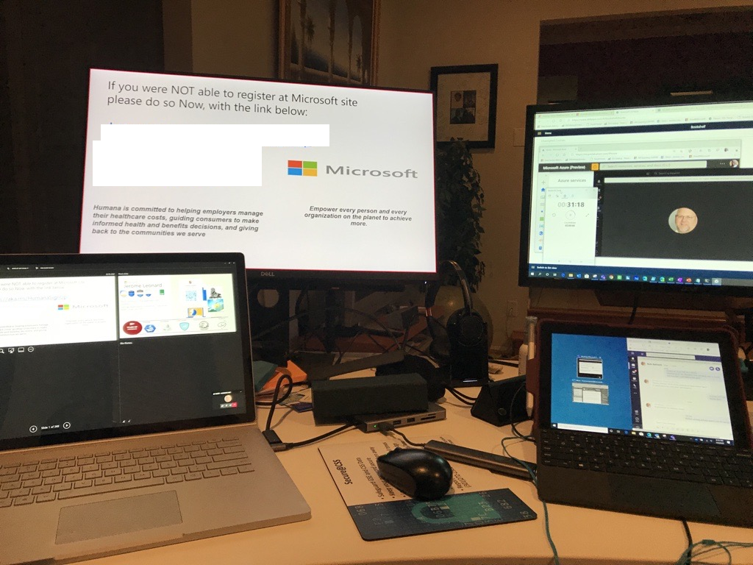
Trainer Home VILT Studios - Examples

Slide 23
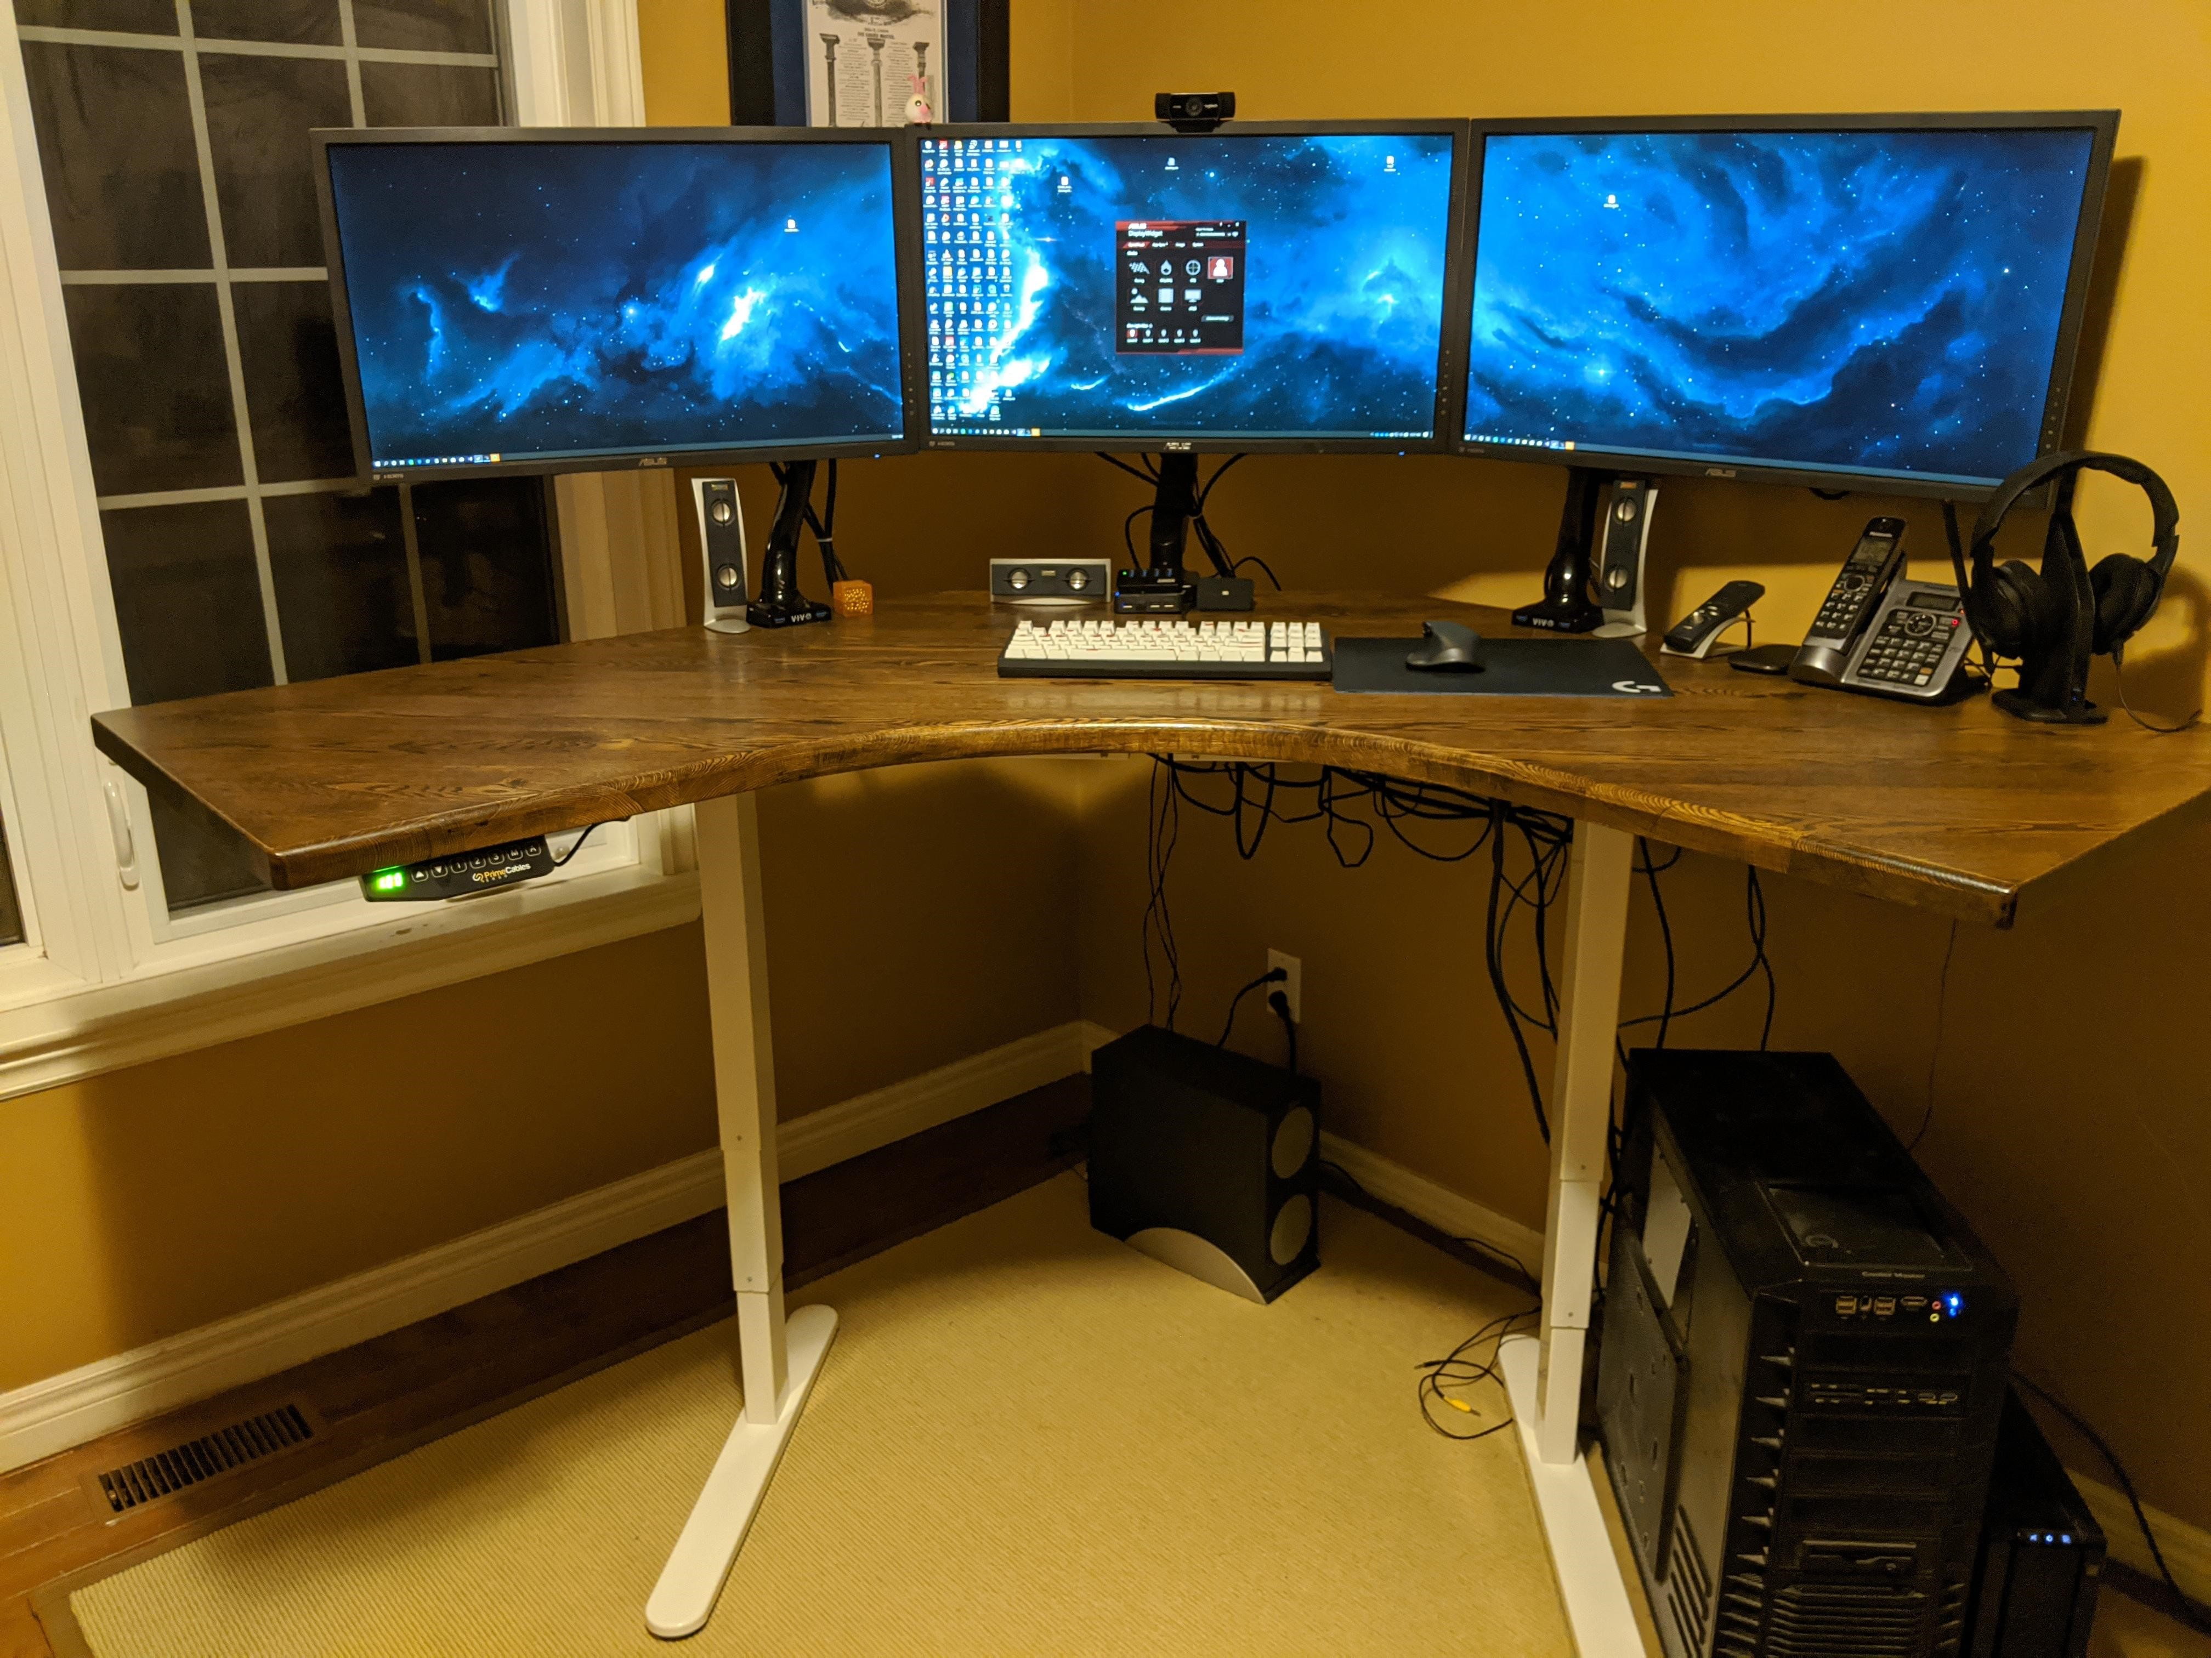
Trainer Home VILT Studios - Examples

Slide 24
Best Practices for Trainers
Summary:
Have the right setup, and practice with it
Drive Student Engagement:
Shorter Lecture time (breaking up into information “chunks”)
Trainer should review content to create shorter intervals between topics
Provide demos or expanded Q&A instead of labs (at least until HOLs are added)
More frequent breaks
Constant group polling // Set expectations that you’ll be calling on people
Smile, move around like you would normally, it creates your normal energy
Encourage student best practices

Slide 25
Best Practices for Trainers
Please ensure "Subtitles" are On in your PowerPoint deck.
Can be distracting but need to be accessible.
Give couple of mins to partners in the end to fill in the survey and please emphasize on the ask.
Notes:
Team, please ensure you have the "subtitles" box checked on for the presentation for accessibility reasons. Let me know if you need any support

Slide 26
Trainers: Things to Know and/or Avoid
To ensure a smooth event & prevent satisfaction problems, here are important things facilitators should keep in mind:
Don't rat-hole on a particular topic or question too long (the agenda timing is tight, and the overall learning experience may suffer)
Instead, document any deep/complex customer questions and use them as an opportunity to follow-up with them after the event
As a facilitator from a partner organization, you are representing Microsoft and CANNOT overtly promote your own solutions or customer offers during the event
Instead, you can (1) use anonymized customer examples from your own experiences to support the learning experience, or (2) offer to follow-up with them in the days/weeks after the event (in alignment with the account's Microsoft seller)
Don’t assume that because you are delivering the event you will automatically become the partner of record for that customer (for the data migration sales cycle)
Instead, you can introduce yourself to the customer attendee (mentioning your company name) during the event, and then work with the Microsoft sales team to see if there's an opportunity to be involved in the sales cycle

Slide 27
Setup & best practices for Students
Being a good instructor starts with a good understanding of the student

Slide 28
Best Practices for Students
Delivering a class to virtual students is a great solution for when travel to a central location is not possible.
For best results we encourage customers to have employees attend Virtual Deliveries from home.
This accomplishes four things:
Addresses COVID-19 concerns (keeps people apart from one another).
Avoids distractions in the workplace.
Provides an option to use personal computers that have rights to install software, no proxy settings, etc. and it may provide dual monitor experience (which is recommended).
Provides a network that likely doesn’t have a firewall blocking apps / ports.

Slide 29
Best Practices for Students
Before the class:
Check the Technical Requirements (appendix)
Check your microphone / headset to be working (cabled, fully charged if wireless, back up device)
If you need to install any virtual class software run a system check/test a day before the start of the class or earlier
Participate from a comfortable environment (quality chair, clean desk, nice room temperature)
Use a comfortable headset, you will be using it all day
Make sure you have enough network bandwidth

Slide 30
Best Practices for Students
During the class
Give priority to the virtual class as if it were an in-person delivery (no side-meetings, no other calls during class hours, no email, etc.)
When logged in before class hours, do participate in the “water tank / coffee machine” chit-chat moments to break the ice
Try to limit background noises or go on mute if needed (colleagues, coffee machine, A/C, etc.)
Ask questions as if it were an in-person delivery
When asking questions, speak at moderate pace, and not too loud
Don’t hesitate to ask for additional explanation
Remember that the trainer doesn’t get any visual cues so respond by voice or via the IM window to attention-checking questions (“everyone still OK”, “all good in the labs”, “any questions”,...)
Be patient when there are technical challenges (noise break-up, slower screen switching from slides / whiteboard / demos)

Slide 31
Using Teams for virtual event delivery

Slide 32
Microsoft Teams Technology Requirements
Teams Tech Test:
Customers don’t need to have Microsoft Teams deployed within their organization to attend a Teams meeting. They can install the Teams client on any machine and join the Teams meeting as a non-authenticated guest.
If they can’t install the full Teams Desktop client, they can use the Teams Web Client: https://teams.microsoft.com.
When starting class they will click on “Join Teams Meeting” which will bring them to web version and provide the choice to install the full client if they wish and are able to or continue with Web Client.
Customers are encouraged to use the Office 365 Network Onboarding tool to test their network for the use of Teams. This tool will download and run an app to test the network from the desired learning location. It will test for a variety of O365 items, including the items as shown in the picture below.

Slide 33
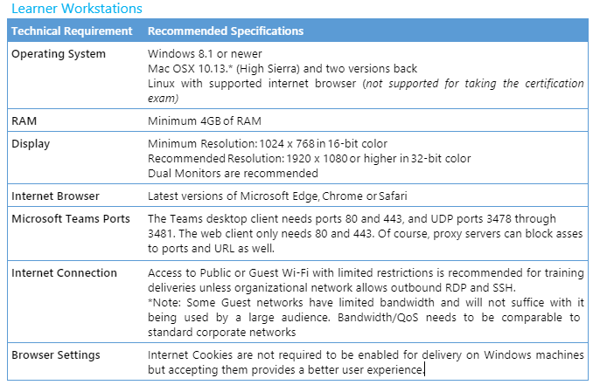
Microsoft Teams Technology Requirements

Slide 34
Supporting customer/attendee access
Ideally the customer will be using their organization’s Teams license, but if not, here are attendee options:
Attendees individuals can sign up directly with Microsoft Teams Free and Teams Exploratory Experience
Customer attendees with decision-making roles can leverage the Office 365 E1 Trial offer
For customers with a Microsoft account manager, the customer should request the passcode from their Microsoft account manager.
Customers with no Microsoft account manager, partners can request the passcode from Partner Center Support (click CSP, then select Cannot find an offer in the catalog)
Click here to get a full list of Teams trials and offers
Trainers can check back for the latest Teams-related guidance at: https://aka.ms/partnerremotework

Slide 35
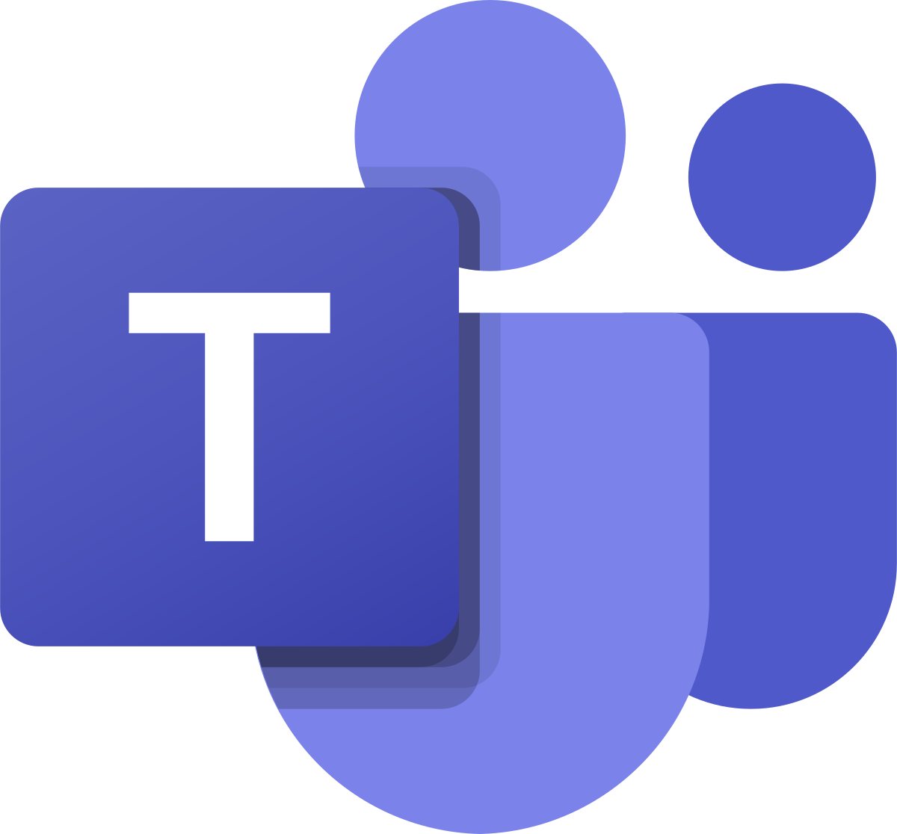
Important things to know about using Microsoft Teams
Guest Access must be turned on (Microsoft host/sponsor should do this)
Microsoft hosts/sponsors can find information on how to do this HERE
Guest Access troubleshooting resources can be found HERE
Delivery partners can learn more by visiting our on-demand end-user training and at our PartnerRemoteWork site
Invitation language for PII/GDPR compliance
“If you choose to participate in this session using Microsoft Teams, your name, email address, phone number, and/ or title may be viewable by other session participants"

Slide 36
Teams Requirements / Resources
External v. guest access in Microsoft Teams
Limits and Specifications for Microsoft Teams

Slide 37
DMIAD Train the Trainer (TTT): Post Event Follow-Up

Slide 38
DMIAD Post Event Follow-Up
The Importance of Post Event Follow-Up
Getting the right customers to a DMIAD event and delivering it well are just two parts of creating data migration momentum within the targeted accounts.
Following up after the event is critical for maintaining that momentum and turning interest into next steps = actions such as POCs or production pilots.
It's essential that delivery partners work closely with DMIAD event coordinators, MS sellers and Data PMMs (BG) to put those follow-up actions into motion.
Leverage the Attendee Follow-Up Mail .OFT (e-mail template on next slide & in TTT BOM) and Best Practices (next slide) to ensure a smooth transition from event to next steps.

Slide 39
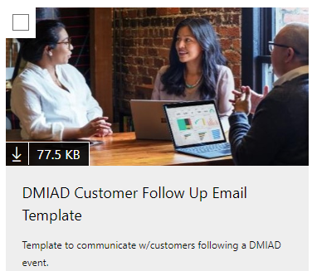
DMIAD Post Event Follow-Up
Attendee Follow-Up Mail .OFT (e-mail template)
Event Follow-Up Best Practices
General: Follow-up with attendees after each delivery (using the post event .OFT), focusing on next steps for maintaining migration momentum (pipe movement)
Specific: Follow-up with attendees who had specific questions, blockers or requests during the session (set next-step meetings)
CRITICAL SUCCESS FACTOR: Work with Microsoft (seller or primary program contact) on opportunity alignment = making sure the opportunity is showing up properly in each company's respective CRM systems (Partner Sales Connect/Partner Center and MSX) accordingly

Slide 40
DMIAD Train the Trainer (TTT) Support :
DMIADptnrsupp@microsoft.com

Slide 41

PARTNERS are the heroes that make this possible!
On behalf of Microsoft, THANK YOU for stepping up to be a delivery partner for “In a Day” events!
We know it’s an investment of time and resources, and we want you to know that WE COULD NOT DO THIS WITHOUT YOU!
Thank you for being the HERO to both Microsoft & our mutual customers!

Slide 42

Delivery Partner Requirements

Slide 43
Data Mod Immersion Delivery Partner Requirements
Delivery Partner Requirements:
Managed & Co-Sell Ready status in the delivery geo (including all bullets below)
Be a managed partner = have a local and/or global Partner Development Manager (PDM)
Hold a Silver or Gold Cloud Competency
Have a Data Migration-related solution published on Microsoft AppSource or Azure Marketplace
Hold an Advanced Specialization in Windows/SQL Server or be in the process of earning it
Selected by local Microsoft team to be a strategic GTM partner for that area
<or> Be a Microsoft Azure Expert MSP partner
<and> Commit to working w/MS on the scheduling of & delivery coordination for Data Mod Immersion Workshop events
Delivery Partner Responsibilities, Post-Event:
Fill out Delivery Partner Evaluation Form within 14 days of event date
Work with Microsoft on any new opportunity/pipe growth related to event attendee follow-up
If following up with an attendee directly, partner will inform Microsoft account sales teams (or area OCP PDM/PMA, or Data PMM) to ensure the MSX pipeline status for the account gets updated – and so the two sides can work the opportunity together
Contact all attendees who asked for specific follow up within 5 business days of the event
(Thru-Partner) Enter attendee information into Partner Center within 14 days of event date

Slide 44
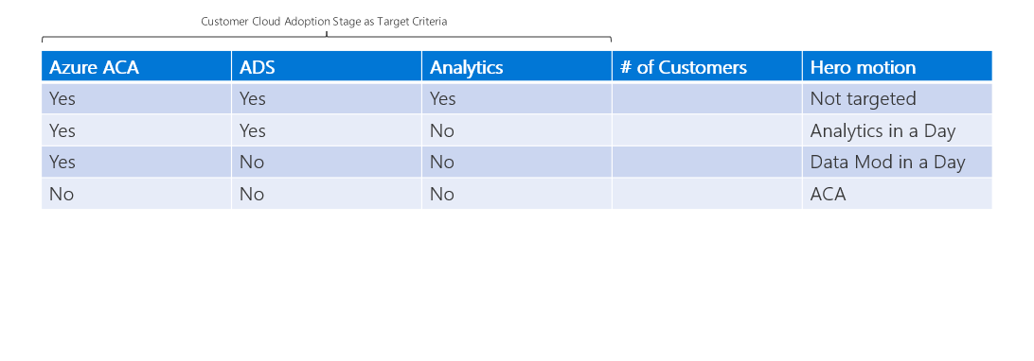
Customer targeting for Data Mod Immersion Workshop
ACA = Azure Customer Adds: Customers consuming Azure for the first time (any Azure)
ADS = Azure Data Services: Azure Consumed Revenue (ACR) that comes from data workloads in Azure
Customer targeting for Data Mod & Analytics Immersion Workshops is based on where customers are in their cloud journey and what (if any) Azure data services they’re already consuming
Propensity Model (ideal target) for Data Mod: Customers who have adopted Azure in some form (e.g. migrated some infrastructure to Azure) but haven’t migrated any data workloads yet

Slide 45
Q&A

Slide 46
Thank You | Feedback​ https://aka.ms/DMIADSession

Slide 47
Moderator Rules of Conduct Samples
We seek to provide a respectful, friendly, professional experience for everyone, regardless of gender, sexual orientation, physical appearance, disability, age, race or religion.
We do not tolerate any behavior that is harassing or degrading to any individual, in any form. Individuals are responsible for knowing and abiding by these standards. We encourage everyone to assist in creating a welcoming and safe environment.
Please report any concerns, harassing behavior, or suspicious or disruptive activity to the virtual event host or moderator or report any concerns, suspicious or disruptive activity or behavior via the Microsoft Runs on Trust website.
Microsoft Code of Conduct We seek to provide a respectful, friendly, professional experience for everyone, regardless of gender, sexual orientation, physical appearance, disability, age, race or religion. We do not tolerate any behavior that is harassing or degrading to any individual, in any form. Individuals are responsible for knowing and abiding by these standards. We encourage everyone to assist in creating a welcoming and safe environment. Please report any concerns, harassing behavior, or suspicious or disruptive activity to the virtual event host or moderator or report any concerns, suspicious or disruptive activity or behavior via the Microsoft Runs on Trust website. Microsoft reserves the right to refuse admittance to or remove any person from Microsoft Ignite or any other future lives and events.
Microsoft will not tolerate harassment or discrimination based on age, ancestry, color, gender identity or expression, national origin, physical or mental disability, religion, sexual orientation, or any other characteristic protected by applicable local laws, regulations, and ordinances. We encourage everyone to assist in creating a welcoming and safe environment. Please report any concerns, harassing behavior, suspicious, or disruptive activity to Business Conduct Hotline (1-877-320-MSFT or buscond@microsoft.com). Microsoft reserves the right to refuse admittance to or remove any person from Microsoft Ignite.

